Slide 1
Business Analytics using Python
Nikhil D Jonathan

Slide 2
“To understand God’s thoughts we must study statistics, for these are the measure of His purpose.”
- Florence Nightingale ‘Lady with the Lamp’

Slide 3
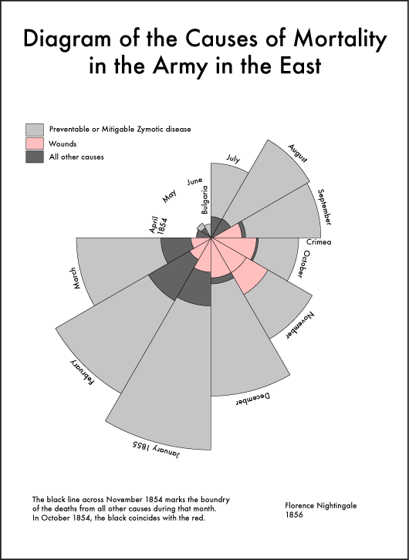

Slide 4
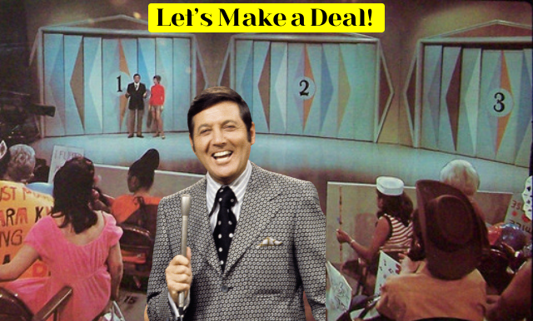
Why Analytics?
The inability of human beings to take decisions.
MONTY HALL PROBLEM (Savant, 1990)

Slide 5
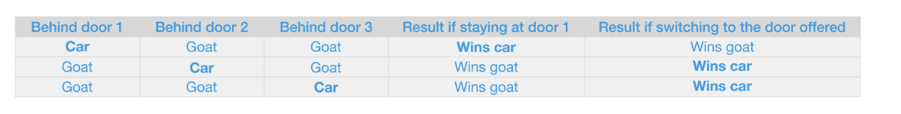
1/3 = 33.33%
2/3 = 66.66%

Slide 6
Why Business Analytics?

Slide 7
Maturity Model of Analytics
Analytics for competitive strategy.
Analytics for Decision Making(e.g. what promotion strategy to use)
Analytics for Problem Solving (e.g. Reduce Inventory Cost)
Analytics for process improvement (e.g. reduce procurement cycle times)
Data is Everything!!

Slide 8
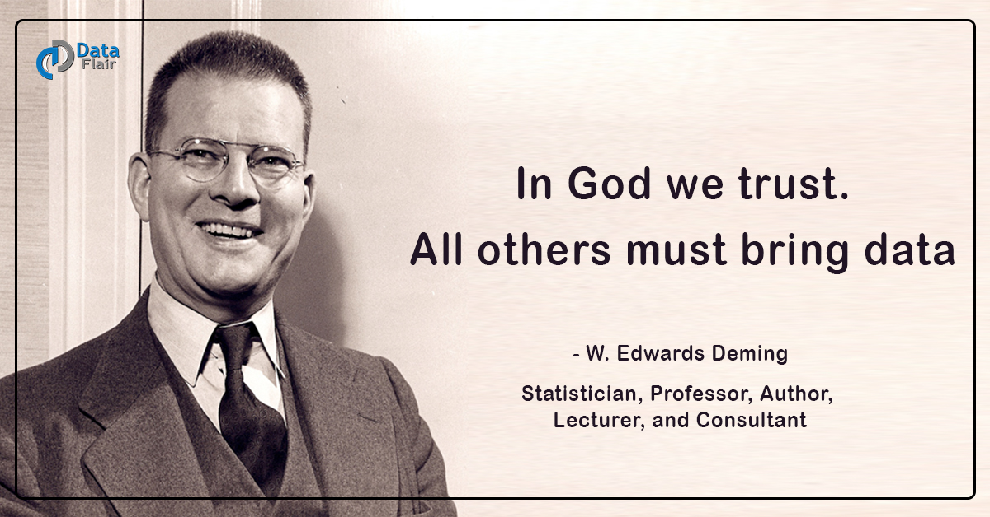

Slide 9
Another Why?
Placement/Career Progression Perspective
Reference:
https://public.tableau.com/app/profile/world.economic.forum.data.analytics/viz/Futureofjobs-skillsontherise/skillsontherise
https://www.weforum.org/publications/the-future-of-jobs-report-2025/

Slide 10
Methods of Business Analytics:
DESCRIPTIVE ANALYTICS: Understand past performance
DIAGNOSTIC ANALYTICS: Discovering why events occurred
PREDICTIVE ANALYTICS: Forecasting Future Trends
PRESCRIPTIVE ANALYTICS: Recommending Optimal Actions

Slide 11
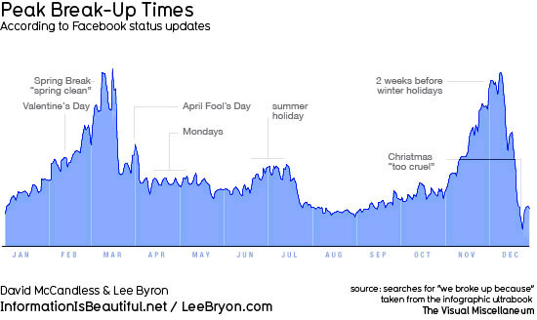

Slide 12
Technology for practical Analytics (Data Warehousing):
Artificial Intelligence - “Agentic Systems, NLP, Transformers”
Machine Learning – “Supervised and Unsupervised”
Statistical Learning – “Linear and Non-linear”
Deep Learning – “ANN, CNN, RNN, LSTM & Reinforcement"

Slide 13
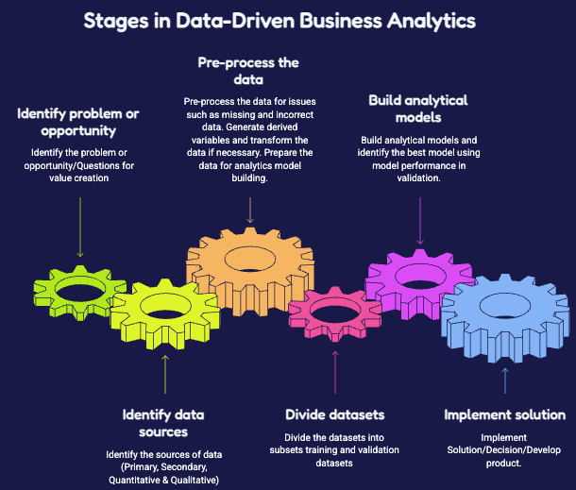

Slide 14
What to expect from the business analytics course??
Skills:
Programming in Python;
Data Processing;
Data Visualizations;
Exploratory Data Analysis;
Statistical Inference & Testing;
Predictive Modelling; ML Fundamentals ;
CRISP-DM;
Data Story-telling; Responsible Analytics;

Slide 15
Let’s make contact with Python
Why Python?
IDE – Kaggle, Colab Research & Anaconda
Working with Python

Slide 16
Analytical thinking remains the most sought-after core skill among employers, with seven out of ten companies considering it essential in 2025, and AI and big data top the list as the fastest-growing skills. (WEF, Future of Jobs Report 2025).
Python is how you do analytical thinking on data.

Slide 17
Python is also super-popular among programmers,
Ref: “The Importance of being earnest(TIOBE) index”
https://www.tiobe.com/tiobe-index/

Slide 18

History of Python
Python is one of the most popular, high-level, general-purpose programming languages. It was created with a focus on code readability and allows developers to write concepts in fewer lines compared to C++ or Java.
Creator: Guido van Rossum
Started: 1989, at Centrum Wiskunde & Informatica (CWI), Netherlands
Named after the BBC comedy series “Monty Python’s Flying Circus”

Slide 19
Integrated Development Environment (IDE) & Notebooks for business analytics:
They are a software tool that allows analysts to write, test, visualize and debug code, in a single narrative document.
Examples: Google Colab, Jupyter Notebooks, Databricks, Anaconda IDE, VS Code, Kaggle and Github Codespaces.

Slide 20
Feature | IDE (VS Code, PyCharm, etc.) | Notebooks (Jupyter, Databricks, Colab)
Execution | Runs the whole file sequentially | Runs code blocks individually
Primary Use | Building apps, APIs, production pipelines | Data analysis, visualization and experimenting
State | Resets every time you run the script | Keeps variables in memory between cells
Code Size | Excellent for massive, multi-file projects | Best for short, linear, single-file scripts
Testing | Bult-in unit testing frameworks | Manual, visual inspection of outputs

Slide 21
Declaring Variables
A variable is a labelled box that stores a value so you can reuse it by name.
You declare a variable with = → name = value
The label is on the left, the value is on the right.
Python figures out the type for you (no need to declare it).
Type | Meaning | Example
int | whole number | units_sold = 250
float | decimal number | price = 49.99
str | text (in quotes) | region = "South"
bool | True / False | is_premium = True

Slide 22
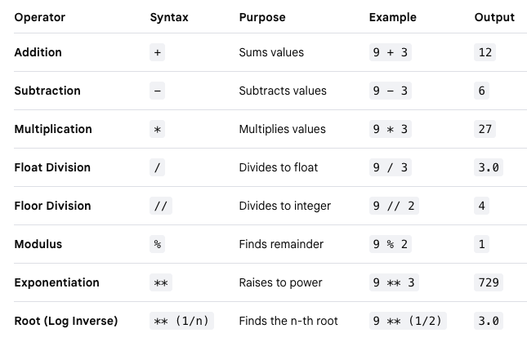

Slide 23
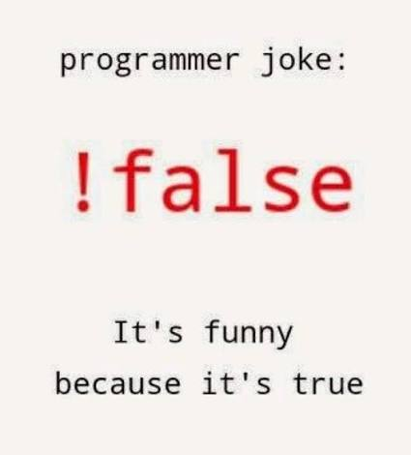
Conditional (Boolean) Variables
A Boolean variable holds only one of two values: True or False.
They usually come from a comparison — a question Python answers with yes/no.
The result of a comparison is a Boolean value you can store in a variable and reuse.
Operator | Question it asks
== | is equal to?
!= | is not equal to?
> < | greater / less than?
>= <= | greater-or-equal / less-or-equal?
and | are both true?
or | is at least one true?
not | flip true ↔ false

Slide 24
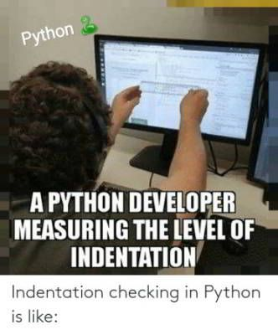
Control Flow Statements
Control flow lets your code make decisions and repeat work — the core of any business rule.
(a) if / elif / else — take a different path depending on a condition.
(b) for loop — do something once for each item in a group.
(c) while loop — keep going until a condition stops being true.
⚠️ Indentation (the spaces) is not decoration — it is the grammar. The indented lines are the ones that belong "inside" the decision or loop.

Slide 25
Collections
A collection holds many values in one variable. The four you will use most:
The dictionary is the most important for business data — it is a labelled record.
Collection | Looks like | Use it when… | Changeable?
List | [10, 20, 30] | ordered items you may edit | Yes
Tuple | (19.0, 72.8) | fixed pair/record that must not change | No
Dictionary | {"key": value} | look up a value by a label | Yes
Set | {"A", "B"} | unique items, no duplicates | Yes

Slide 26
Functions
A function is a reusable recipe.
You write the steps once, give it a name, and call it whenever you need it — no copy-paste.
def starts the recipe.
Inputs go in the brackets — these are parameters.
return hands back the answer.
Why it matters: functions stop you repeating yourself and make analysis auditable — everyone runs the same logic.

Slide 27
Functional Programming
A style where you apply a function across a whole collection at once, instead of writing a loop by hand. It is shorter and closer to how data tools (like pandas) actually work.
Three tools:
lambda — a tiny one-line unnamed function.
map — apply a function to every item.
filter — keep only the items that pass a test.
List comprehension — the readable Python way to do both.

Slide 28
Modules & Packages
You never build analytics from scratch. A module/package is a ready-made toolbox someone else wrote that you import.
import math — a built-in toolbox.
import pandas as pd — the industry toolbox for data tables (a package). as pd gives it a short nickname.
This is the bridge to the rest of the course:
pandas for data
Matplotlib & seaborn for charts
scikit-learn for machine learning — all imported this same way.

Slide 29
“This was one of the best parts of being a coder, and an artist: the thrill of being in the middle of creating something delightful. It’s like the anticipation of eating freshly baked bread after its aroma fills the room.” – Dr. Joy Buolamwini, Unmasking AI
“The code you write makes you a programmer. The code you delete makes you a good one. The code you don’t have to write makes you a great one.” – Mario Fusco, Principal Software Engineer at Red Hat
“The function of good software is to make the complex appear to be simple.” – Grady Booch, Chief Scientist for Software Engineering at IBM Research

Slide 30
“Code is read much more often than it is written.” – Guido Van Rossum, creator of Python
“Learning to write programs stretches your mind, and helps you think better, creates a way of thinking about things that I think is helpful in all domains.” – Bill Gates, Microsoft co-founder

Slide 31
Project Work – Teams – Tracks – Evaluation Pattern
Mid-Term – Case-Studies & Questions (1)
End-Term – Case Studies & Questions (3)
Classroom Activities & Assignment – Case-Studies and Questions (3)

